Slide 1
ECE4750
Evaluating a Dot Product Microbenchmark
Analyzing the Average Memory Access Latency.
TinyRV1 Single-Issue Scalar Processor
TinyRV1 Dual-Issue Superscalar Processor
Two-Way Set Associative Cache

Slide 2
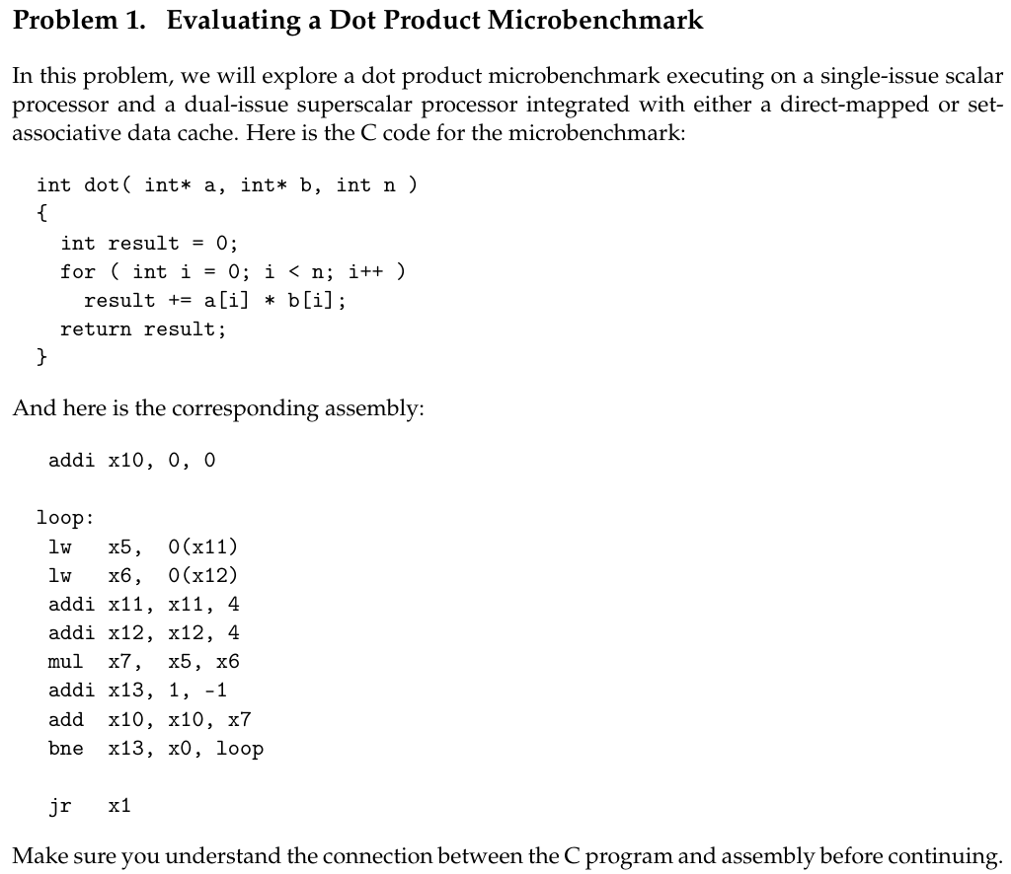
We are scheduling these instructions to help avoiding stalls due to raw hazards

Slide 3
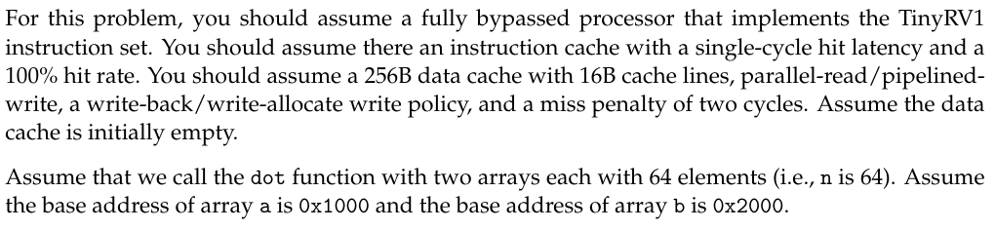
Instruction cache (I-cache)
Implements TinyRV1 instruction set.
Single-cycle hit latency (each instruction fetch takes 1 cycle on a hit).
100% hit rate (no instruction cache misses at all).
Data cache (D-cache)
Total size: 256 B.
Cache line (block) size: 16 B.
Parallel-read / pipelined-write organization.
Write policy: write-back.
Allocation policy: write-allocate on a write miss.
Miss penalty: 2 cycles per miss.
Initially empty at the start of the problem.
The dot function is called with two arrays, each containing 64 elements (i.e., n = 64).
The base address of array a is 0x1000.
The base address of array b is 0x2000.

Slide 4
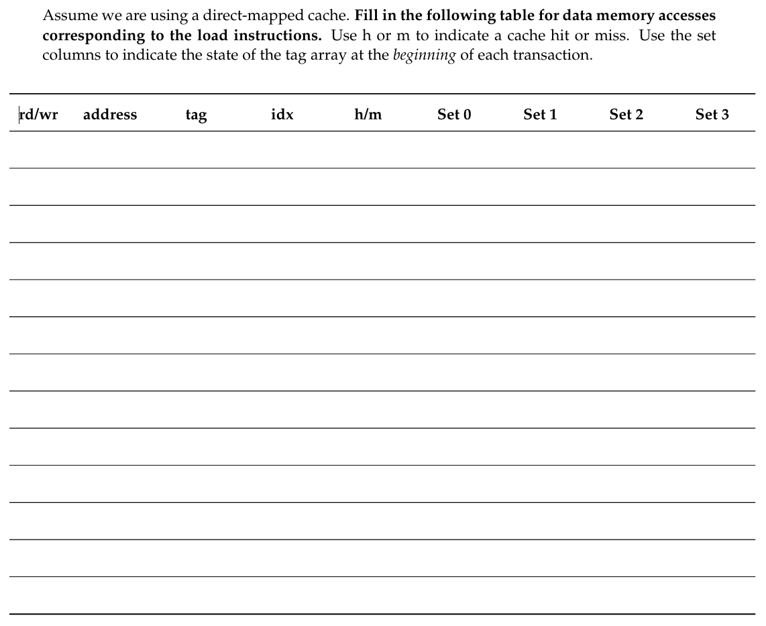
Data cache (D-cache)
Direct-mapped
Total size: 256 B.
Cache line (block) size: 16 B.
  Number of lines: 256 B / 16 B = 16 lines.
Parallel-read / pipelined-write organization.
Write policy: write-back.
Allocation policy: write-allocate on a write miss.
Miss penalty: 2 cycles per miss.
Initially empty at the start of the problem.
rd
0x1000
10
0
m
-
-
-
-
rd
0x2000
20
0
m
10
rd
0x1004
10
0
m
20
rd
0x2004
20
0
m
10
rd
0x1008
10
0
m
20
rd
0x2008
20
0
m
10
rd
0x100C
10
0
m
20
rd
0x200C
20
0
m
10
rd
0x1010
10
1
m
20
rd
0x2010
20
1
m
10
rd
0x1014
10
1
m
20
rd
0x2014
20
1
m
10
20

Slide 5
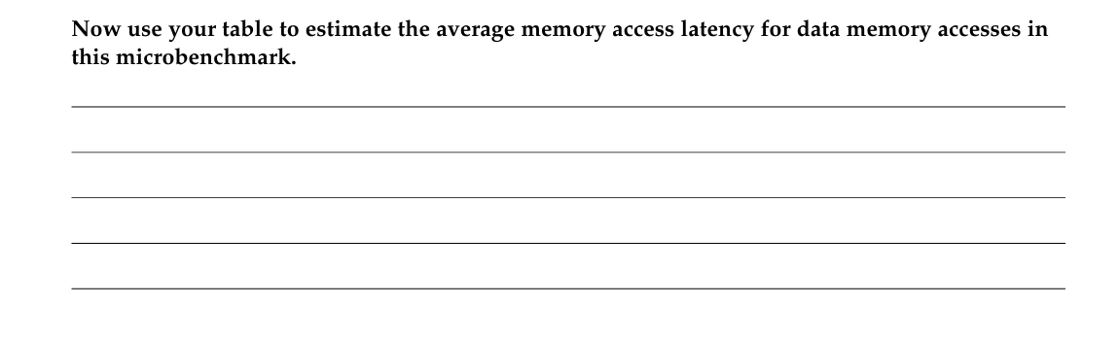
AMAL = Hit Latency + Miss Rate * Miss Penalty
= 1 + 1 * 2 = 3 cycles

Slide 6
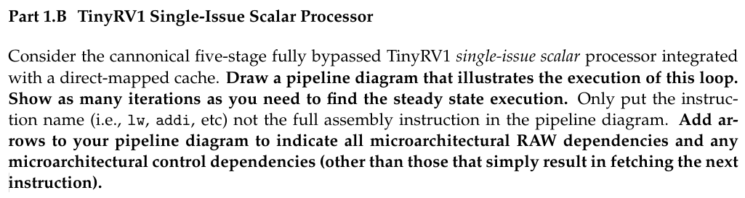
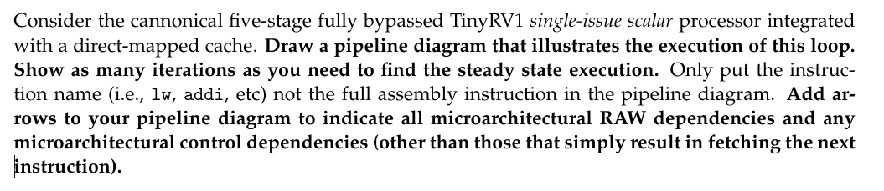

Slide 7

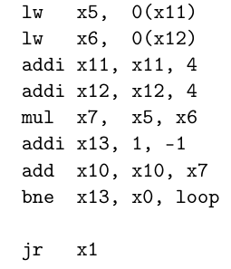
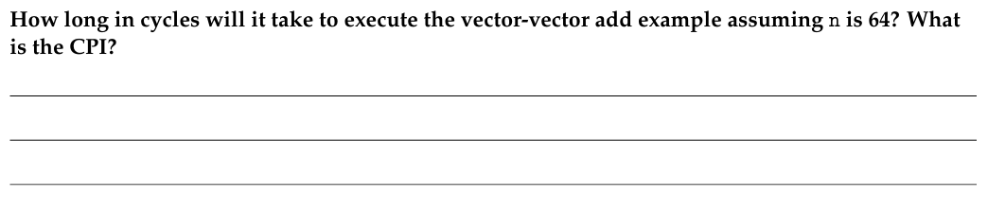
F
D
X
M
M
M
W
F
D
X
X
X
M
M
M
W
F
D
D
D
X
X
X
M
W
F
F
F
D
D
D
X
M
W
F
F
F
D
X
M
W
F
D
X
M
W
8 Instructions
F
D
X
M
W
Stalls due to miss
F
D
X
M
W
F
D
-
-
-
Op A
F
-
-
-
-
F
D
X
M
M
M
W
14 Cycles
n = 64 => Total cycles =14 Cycles * 64 =896 Cycles
CPI = (14*64)/(8*64)=14/8=1.75

Slide 8
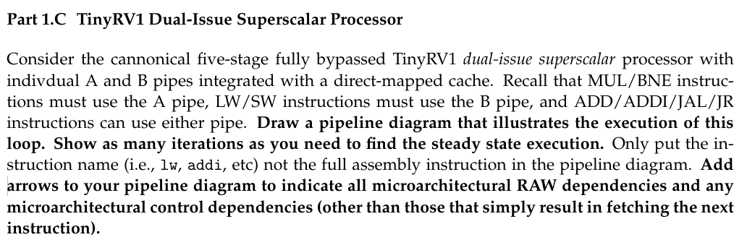

Slide 9

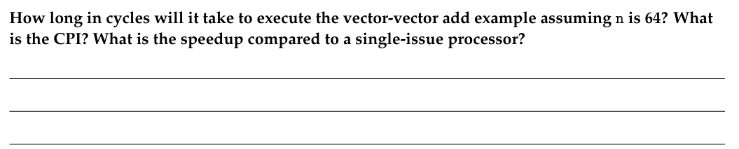
F
D
B0
B1
B1
B1
W
11 Cycles
F
D
D
B0
B0
B0
B1
B1
B1
W
F
F
D
D
D
A0
A0
A0
A1
W
F
F
D
D
D
B0
B0
B0
B1
W
F
F
F
D
D
D
A0
A1
W
F
F
F
D
D
D
B0
B0
W
F
F
F
D
B0
B1
W
F
F
F
D
A0
A1
W
F
D
-
-
-
Op A
F
D
-
-
-
Op B
Stalls due to miss
F
-
-
-
-
Op C
F
-
-
-
-
F
D
B0
B1
B1
B1
W
F
D
D
B0
B0
B0
B1
B1
B1
W
n = 64 => Total cycles =11 Cycles * 64 =704 Cycles
CPI = (11*64)/(8*64)=11/8=1.375
Speedup = (14*64)/(11*64)=14/11=1.27

Slide 10
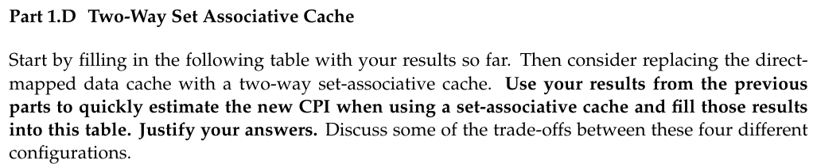
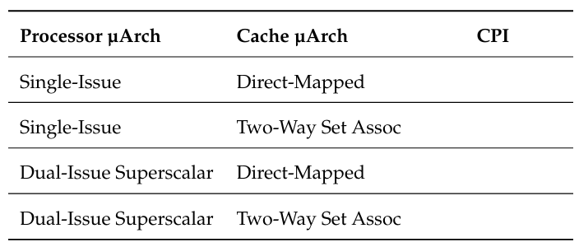
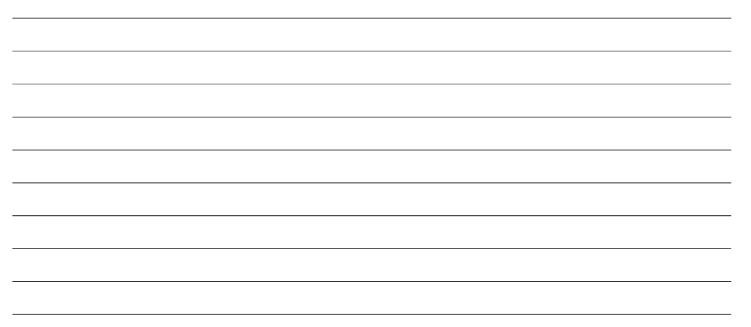
1.75
1.375
1.375
1
Single Issue:
In iteration 0 => 14 cycles (still compulsory misses)
In Iteration 1,2,3 => 10 cycles (since there is not any stall due to misses)
=> Average cycles per iteration = 14*0.25 + 10*0.75=11 cycles/iter.
=> CPI= 11/8=1.375
Dual Issue
Iteration 0 => 11 cycles (still compulsory misses)
Iteration 1,2,3 => 7 cycles (since there is not any stall due to misses)
=> Average cycles per iteration = 11*0.25 + 7*0.75=8 cycles/iter.
=> CPI= 8/8=1

